Slide 1

Frameworks in PHP
Lasha Tavlalashvili

Slide 2

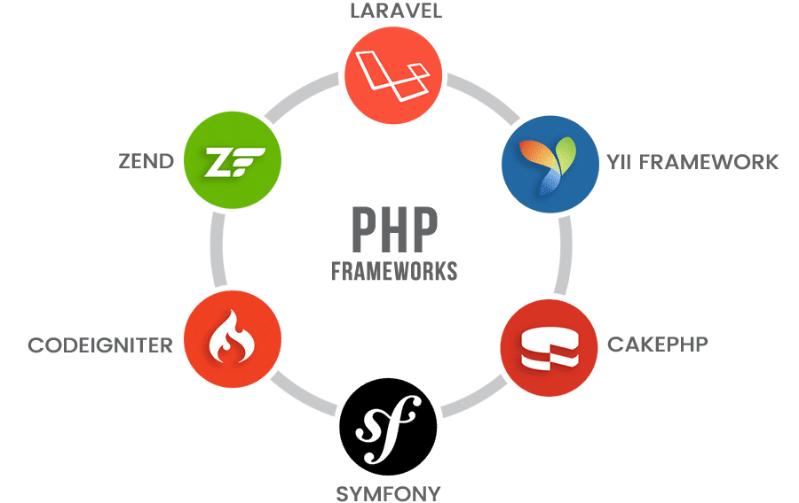
Frameworks In PHP

Slide 3

Laravel Framework

Slide 4
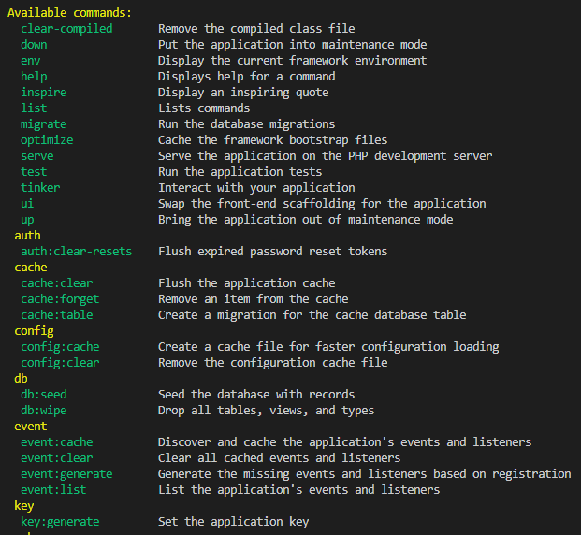
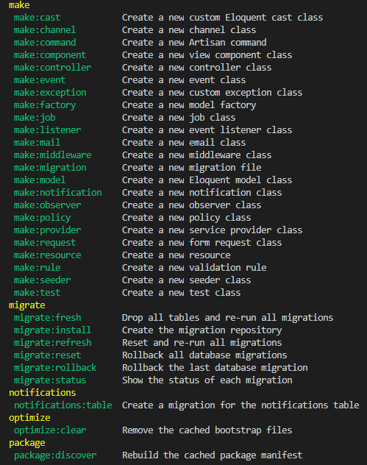
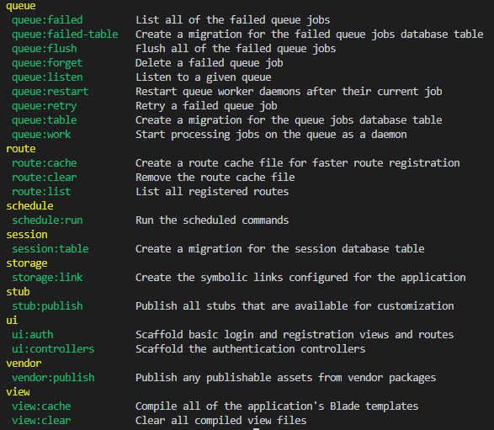
Terminal Commands

Slide 5
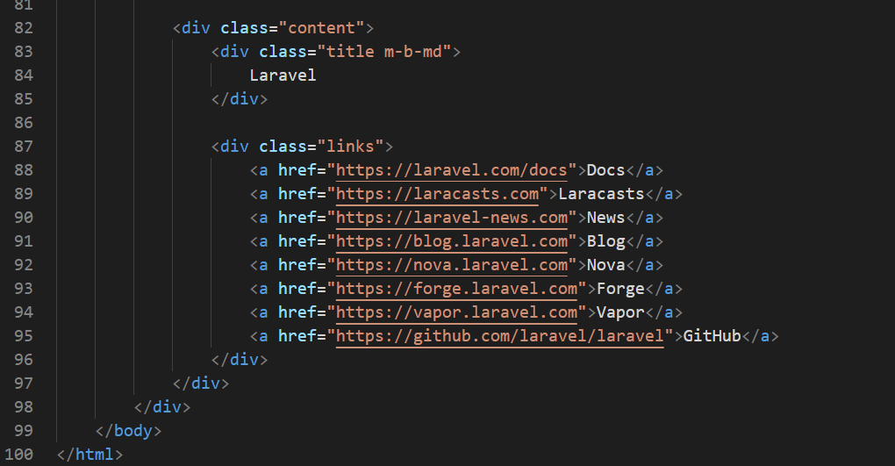

Slide 6


Slide 7
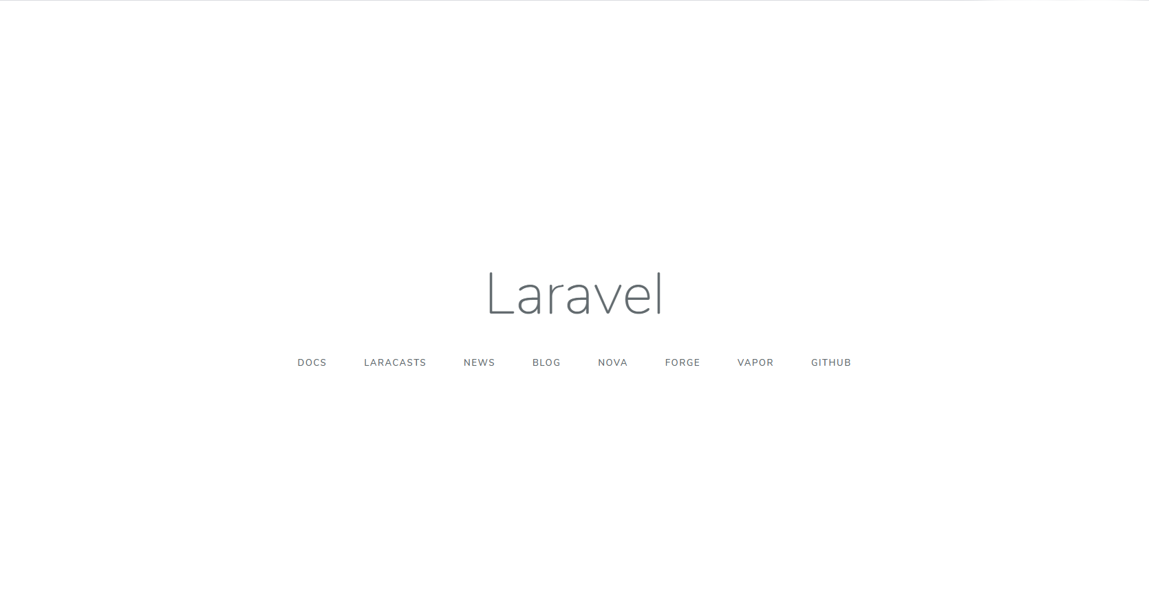

Slide 8


Slide 9


Slide 10
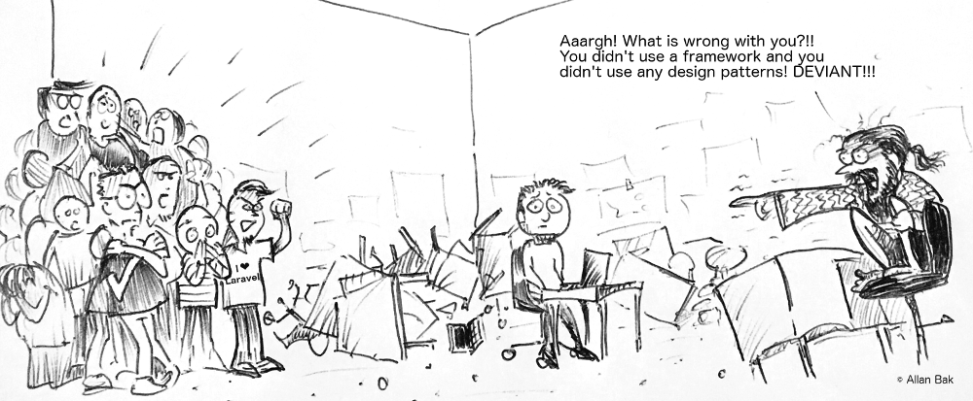
გმადლობთ ყურადღებისთვის!

